Slide 1
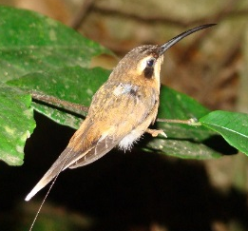
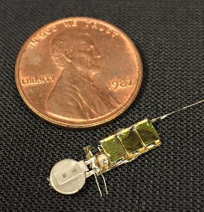
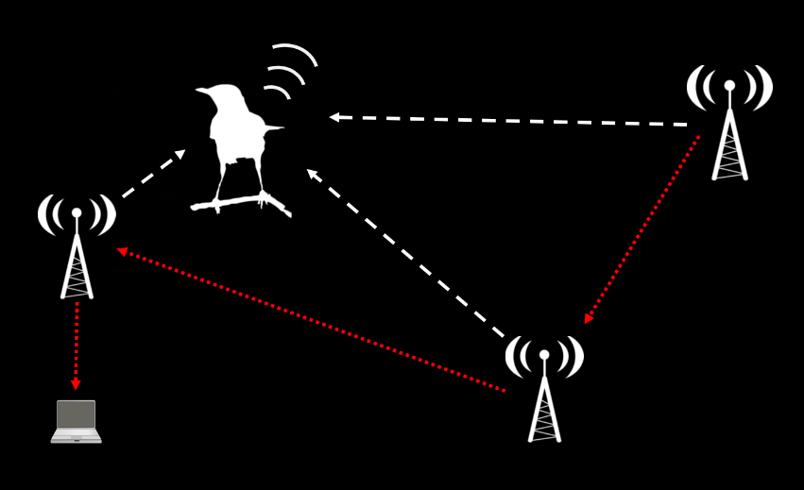
AMRUPT (Animal Movement Research Using Phase-based Trilateration)

Slide 2
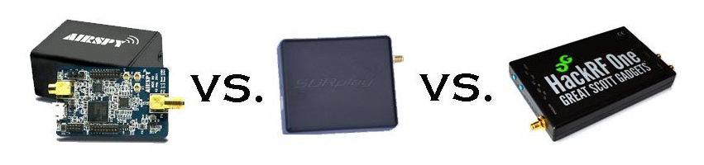
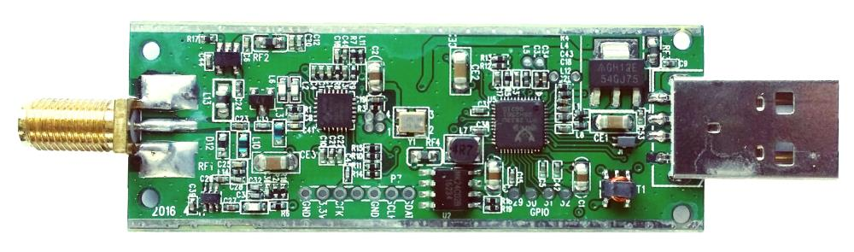
Technical Approach:
Receiver architecture
Will the CC1310 be sufficient for DF?
What about SDRs?
RTL-SDR
$20

Slide 3
Data
4 antennas – allows for Watson-Watt AOA measurement
LNA – Improved SNR
4 RF switches and noise generator – switching in RF noise calibrates for initial phase offsets due to program execution differences
RTL-SDR – cheap ($20) SDRs which can be synchronized with a common local oscillator, and fast I/Q sampling (2 Msps)
Clock – dedicated board with highly stable (0.1 ppm) TCXO and enough drive strength for multiple SDRs, synchronize SDRs
Raspberry Pi – cheap interface for DSP, and to control Clock, Noise generator, RF switches, and SDRs
Data/Control
Control
Clock
Antenna 1
LNA
RF switch
RTL SDR
Raspberry Pi
Antenna 2
LNA
RF switch
RTL SDR
Antenna 3
LNA
RF switch
RTL SDR
Antenna 4
LNA
RF switch
RTL SDR
Noise generator

Slide 4
Data
Data/Control
Control
Clock
Antenna 1
LNA
RF switch
RTL SDR
Raspberry Pi
Antenna 2
LNA
RF switch
RTL SDR
What about transmitting commands to the mobile nodes?
CC1310
Antenna 3
LNA
RF switch
RTL SDR
Antenna 4
LNA
RF switch
RTL SDR
Noise generator

Slide 5
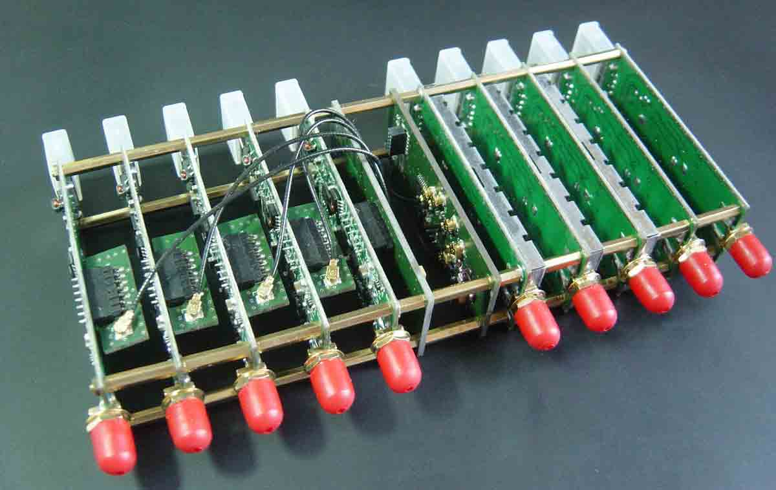
Boards available from www.coherent-receiver.com

Slide 6
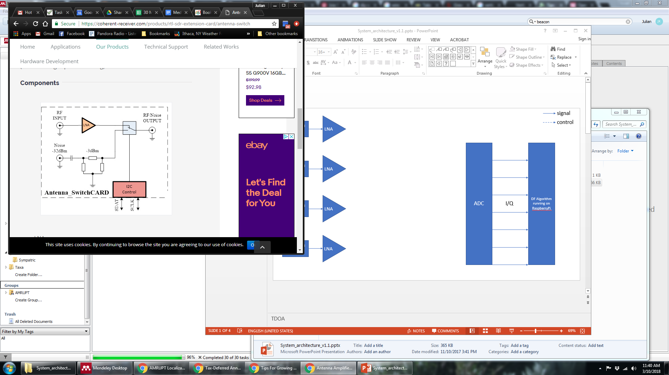
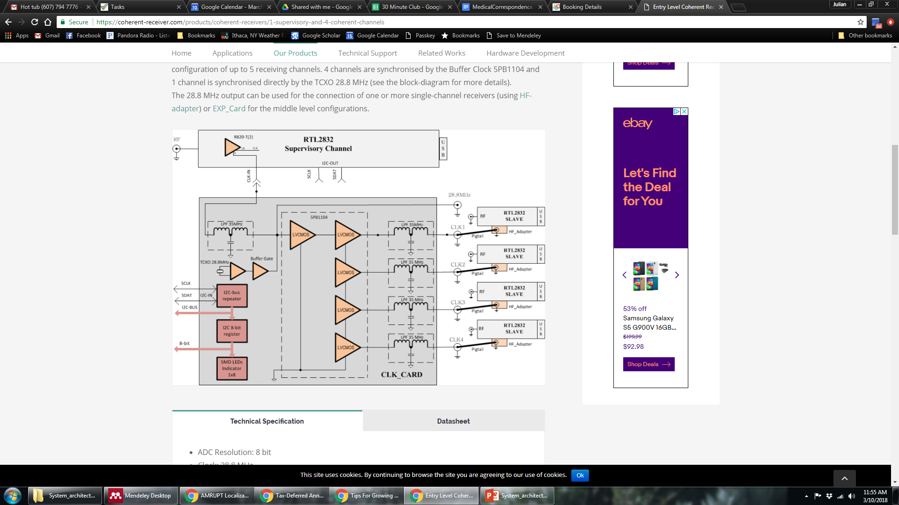
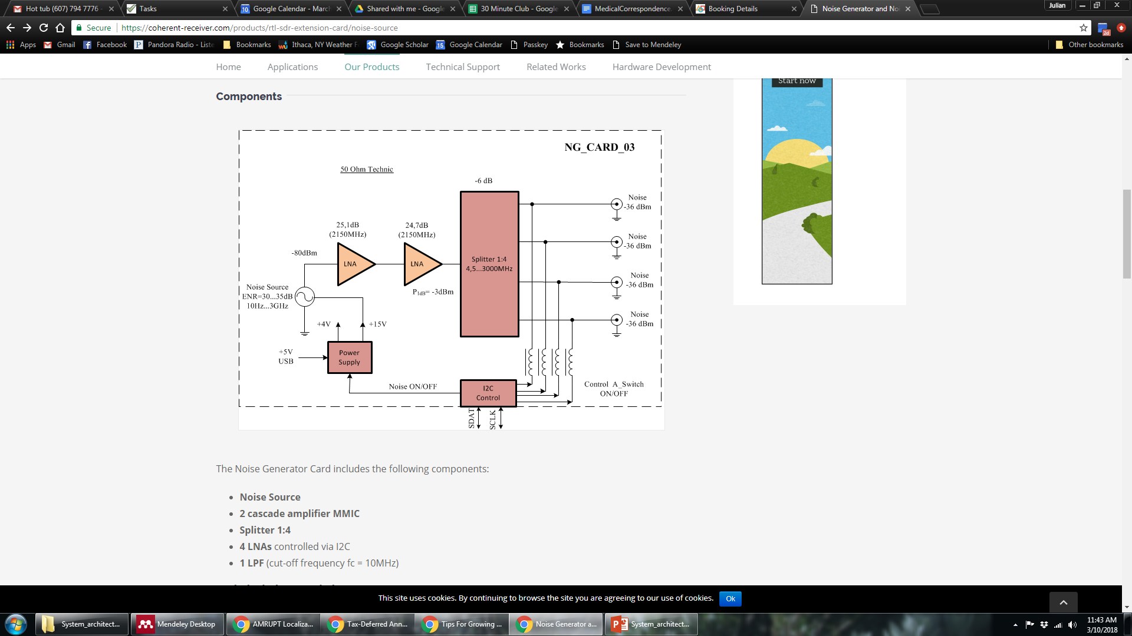
Boards available from www.coherent-receiver.com
We must reverse-engineer and simplify design to reduce cost!!
Antenna 1
$75
Antenna 2
$75
$80
$110
Antenna 3
$75
DF Algorithm running on RaspberryPi
Antenna 4
$75

Slide 7
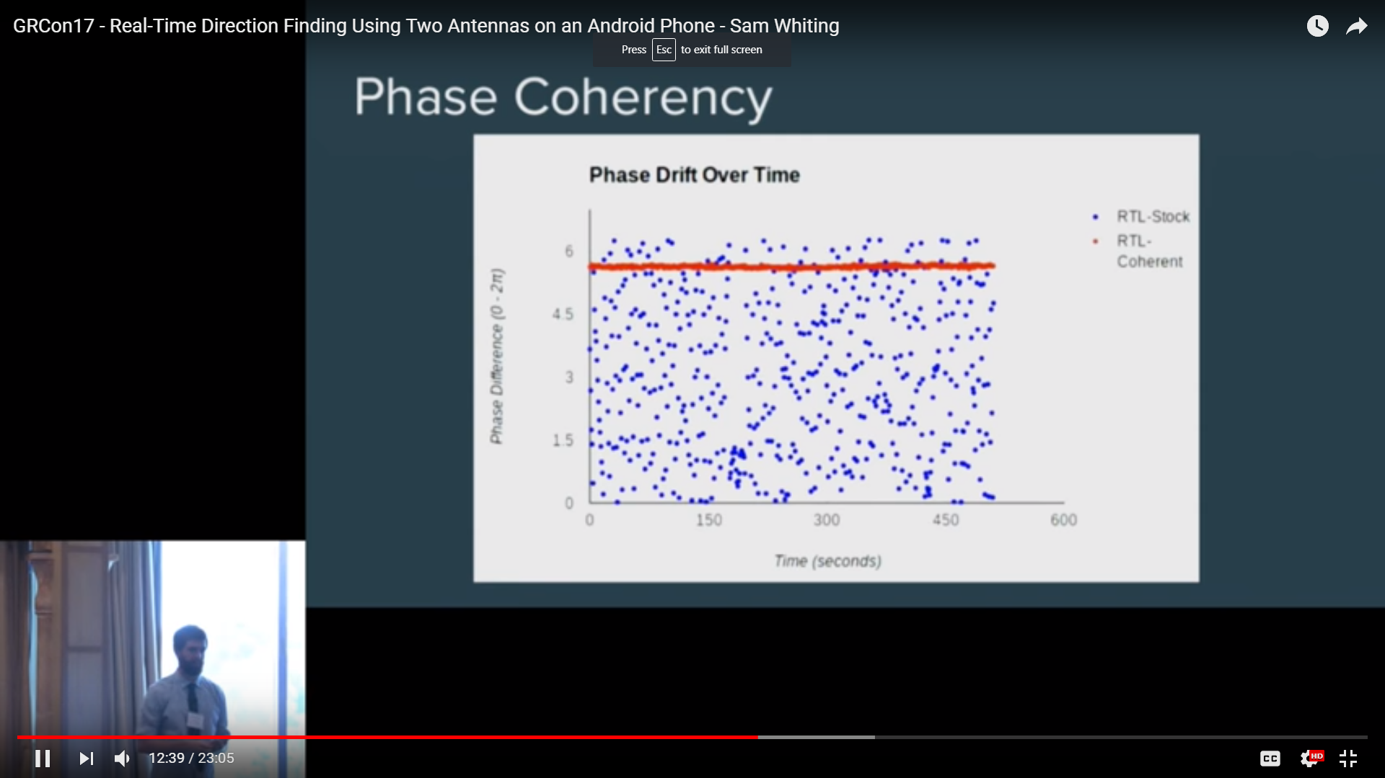
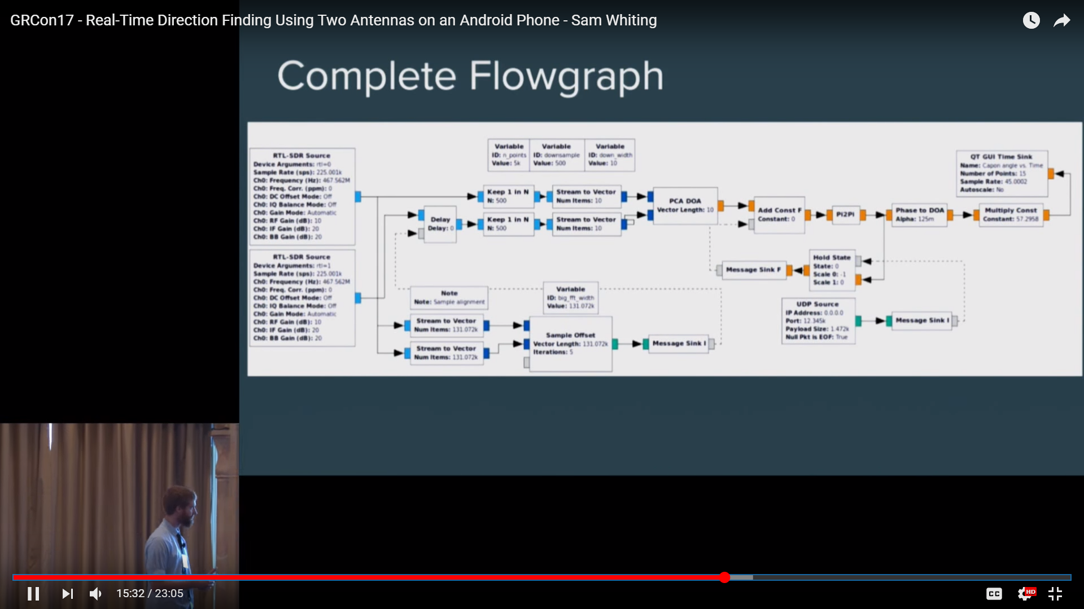
Software/DSP: GNU Radio
Calibrate for constant phase offset between 2 channels w/ switched-in RF noise signal (?)
2 RTL-SDRs
Downsample to 1.5 ksps
Phase diff.
Compensate for time delay using Xcorr w/ switched-in RF noise signal
Use existing SDR hardware, rather than proprietary systems
Existing code blocks for high-level functionality
Simulate RF signals and signal processing
Create DSP algorithms for processing real output from RTL-SDR sources
Well supported, open-source, and free

Slide 8
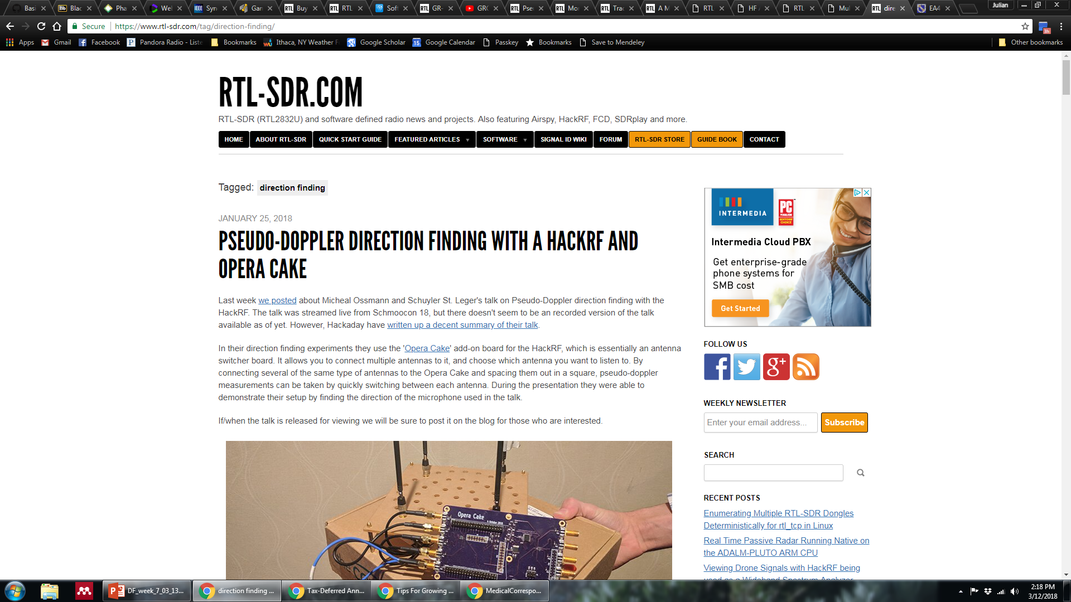
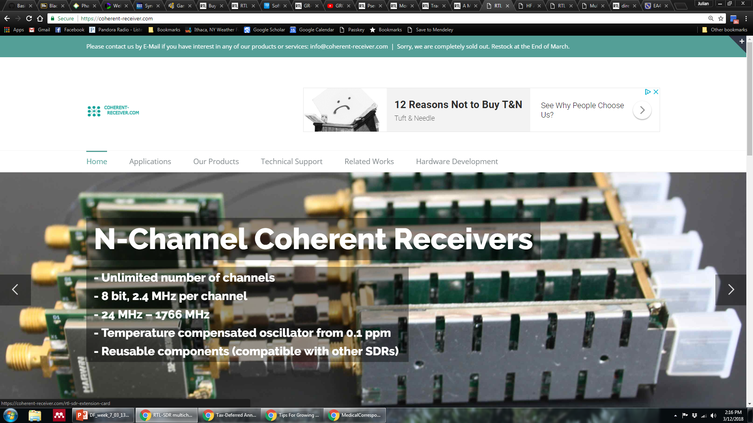
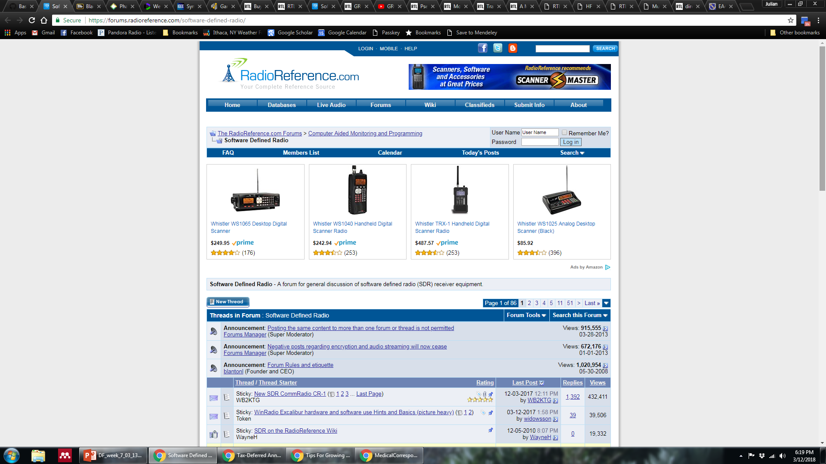
Resources to jump-start our project
www.RTL-SDR.com
www.coherent-receiver.com

Slide 9
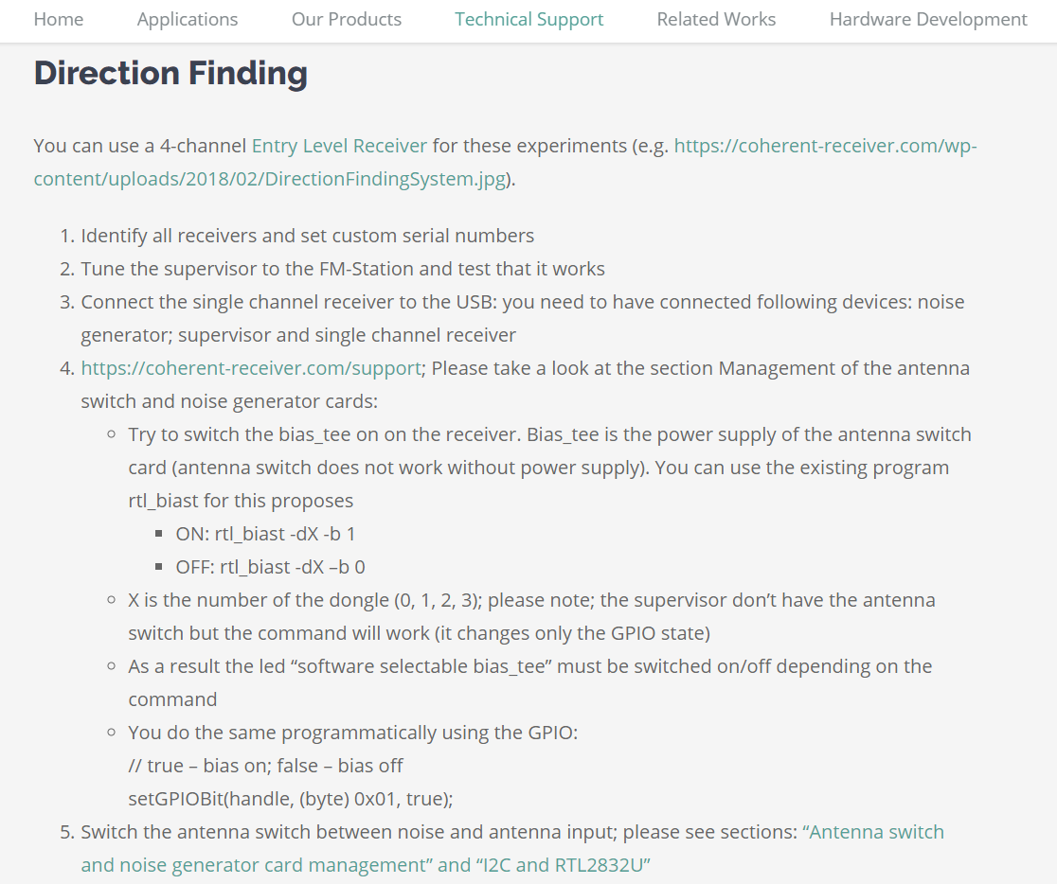
Coherent-receiver.com – provides support for RDF

Slide 10
Communications with Coherent-Receiver.com
“I don’t think that the open sourcing will reduce the prices.
Initially, we developed this project for the commercial customer in order to improve the reception in the moving objects; the second idea was to use it in DRM30. Our public available realisation was made as flexible as possible incl. different components versions for various application scenarios, e.g. clock-card10 or clock-card 0.2/2. You can consider these products as development boards in order to test your ideas or make some research. These were not intended to be and are not the mass-market products.
The design and realization for volume products (with cheaper prices) should be different. We designed such version for the above mentioned application scenario but cannot provide more details at the moment.
We provide the detailed description about the public available products. Moreover, you can ask the technical questions that we will try to answer.”

Slide 11
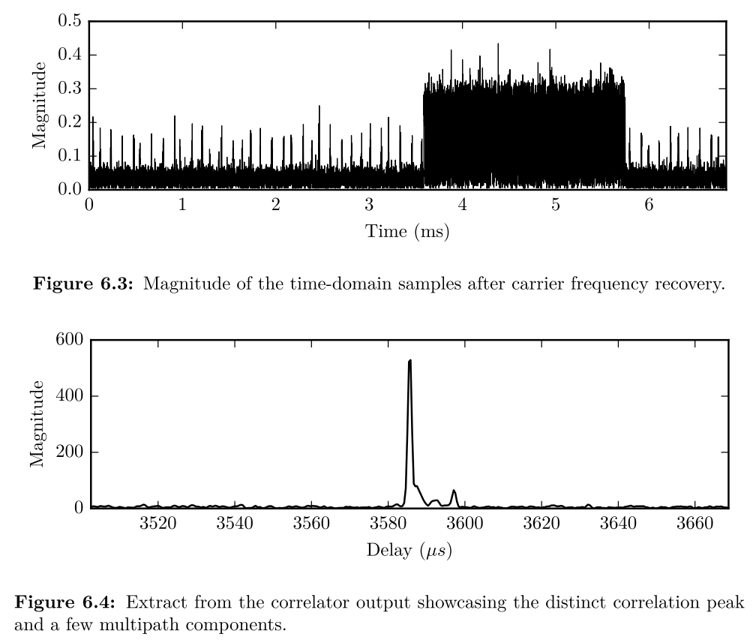
Resources to jump-start our project
www.RTL-SDR.com
www.coherent-receiver.com
www.radioreference.com
GitHub repositories:
RTL-Coherent
Multi-RTL
Gnuradio-doa (video)
Thrifty
System compatible with TDOA or TDOA/AOA-hybrid approaches

Slide 12
Where to go from here?
Review existing SDR DF designs
Learn about (and test-drive) GNU Radio Companion
Continue to formulate specific questions for Dr. Kan and his students for next week’s meeting with him, focusing on evaluating the compatibility of SDRs with his approach
Finish up proposal revisions, incorporating SDR approach
Don’t forget to update timeline with realistic milestones!

Slide 13
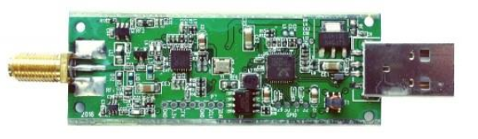
The RTL2832 SDR Dongle
Russell Silva – AMRUPT, Spring ‘18

Slide 14
General Information
“RTL-SDR is a very cheap software defined radio that uses a DVB-T TV tuner dongle based on the RTL2832U chipset. With the combined efforts of Antti Palosaari, Eric Fry and Osmocom it was found that the signal I/Q data could be accessed directly, which allowed the DVB-T TV tuner to be converted into a wideband software defined radio via a new software driver.” – rtl-sdr.com
“The whole RTLSDR thing is fluke and not an intentional product. Basically 1.5 years ago someone discovered a stealth test mode on a commercial satellite TV receiver USB and it popped up on Reddit and the rest is history.” – Reddit Post
The nature of the semiconductor and electronics industries in Asia is highly competitive so they are über paranoid about sharing information.” – Reddit Post
“An enterprising hacker, Eric Fry, found that the device sends IQ data over the USB connection that can allow us to use it as an SDR. A lot of smart folks wrote code for linux, windows, etc and now we can use that IQ data as a means to listen to and view signals that the RTLSDR receives.” – Reddit Post
Notes:
There are many other software defined radios better than the RTL-SDR, but they all come at a higher price. Currently we think that the Airspy ($199) and SDRPlay ($149) SDR’s are the best low cost RX only SDR’s. Then there are the HackRF ($300USD) and BladeRF SDRs ($420 and $650), which can both transmit and receive.

Slide 15
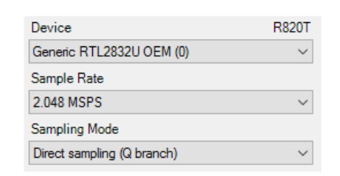
Concerns:
Highest Safe Sampling Rate of the I/Q Extraction: 2.56 MS/s (Superkuh)
Superheterodyne devices – Employs IF mixing; however, it is unclear whether I/Q signals can be taken after this stage
No Formal Datasheet
RTL-SDR Blog V3 Datasheet
(rtl-sdr.com)
Notes:
The highest safe sample rate is 2.56 MS/s but in some situations up to 3.2 MS/s works without USB dropping samples (RTL2832U drops them internally).

Slide 16
Clock selector jumper
Clock selector jumper – “By soldering in a 4 pin 1.27mm pitch jumper header and removing the default 0 Ohm resistor, one can now easily select between the onboard clock, an external clock, or having the on board clock be the output for another dongle. This is for advanced users only who want to experiment with things like passive radar, and coherent receivers.” (RTL-SDR Blog V3 Datasheet – rtl-sdr.com)

Slide 17
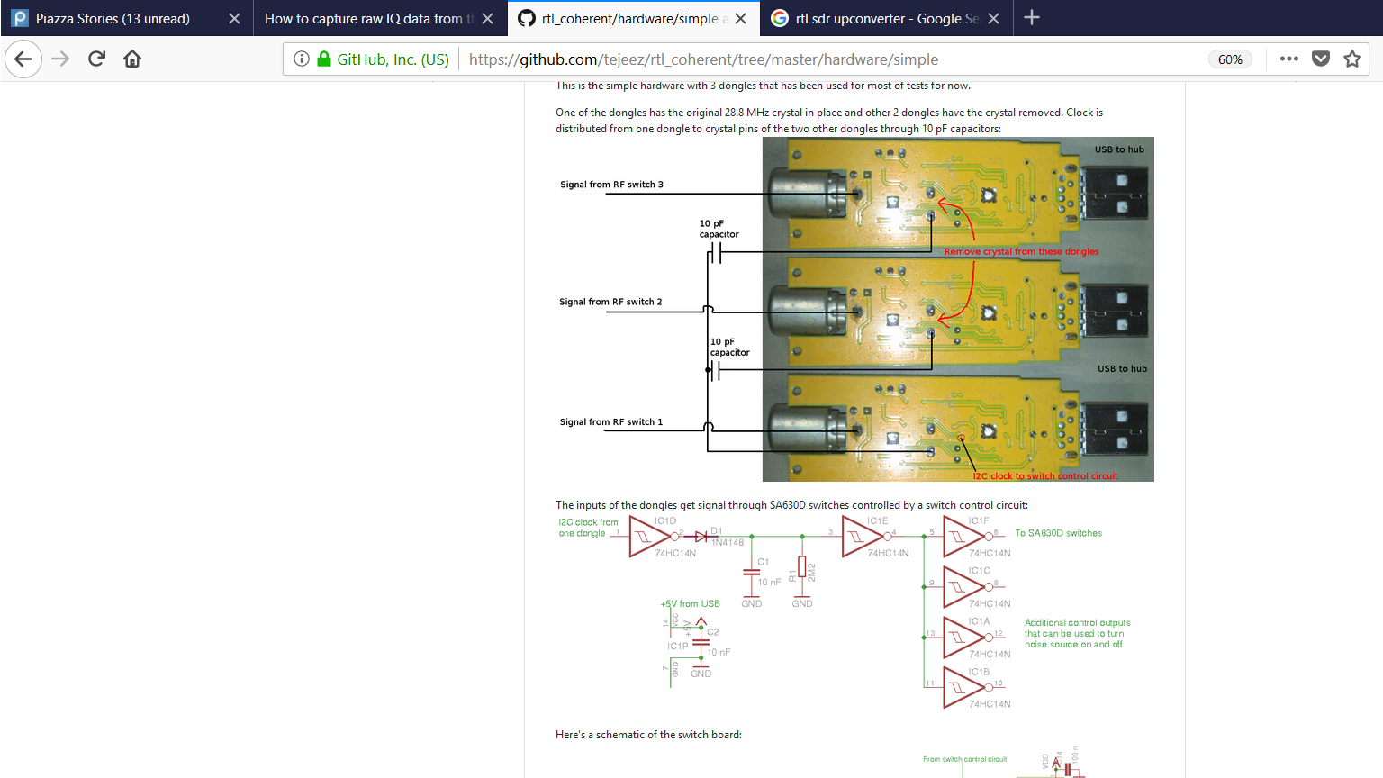
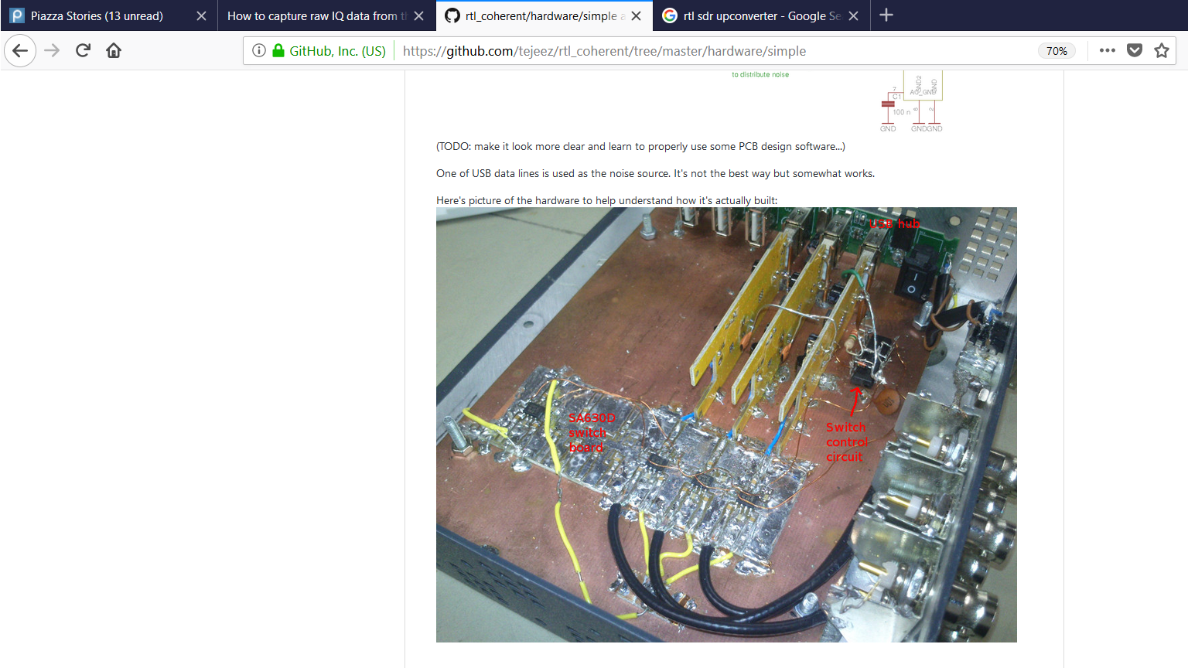
Phase Interferometry Project using RTL SDRs (tejeez – Github)

Slide 18
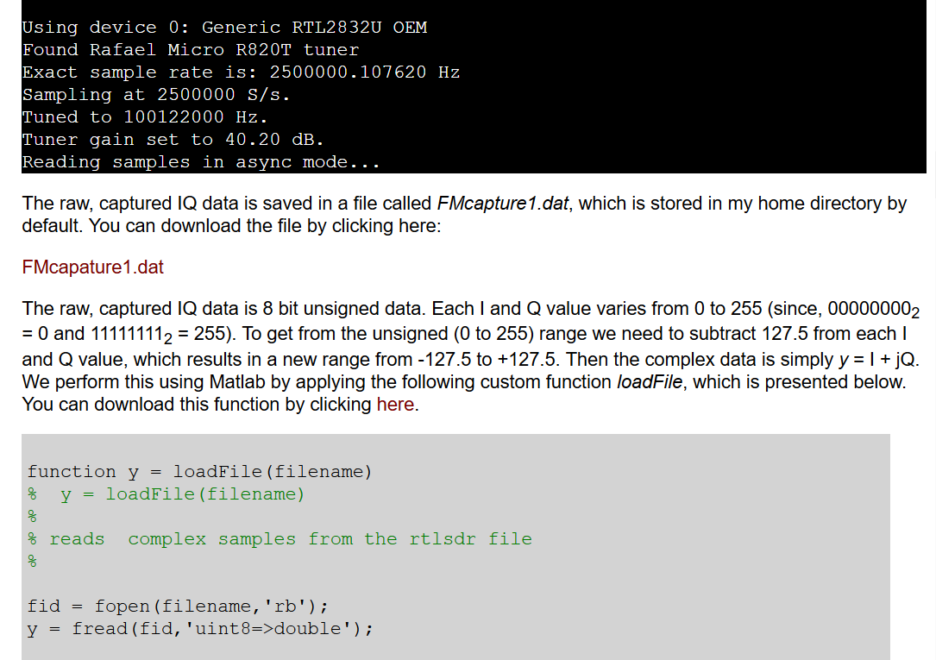
GNU Radio Software:
“How to capture raw IQ data.” (Dr. Aaron Scher, 2015)

Slide 19
Sources:
http://superkuh.com/rtlsdr.html: “Central Hub” source for RTL SDR Information
https://github.com/tejeez/rtl_coherent: Phase Interferometry Project using RTL SDRs
https://www.reddit.com/r/RTLSDR/comments/6n9hdk/welcome_new_visitors_a_little_info_about_rtlsdr/ Reddit Post detailing how RTL SDRs became popular
https://www.rtl-sdr.com/about-rtl-sdr/: General Information
https://www.rtl-sdr.com/buy-rtl-sdr-dvb-t-dongles/: Buying Location
aaronscher.com/wireless_com_SDR/RTL_SDR_AM_spectrum_demod.html “How to capture raw IQ data,” (Dr. Aaron Scher, 2015)

Slide 20
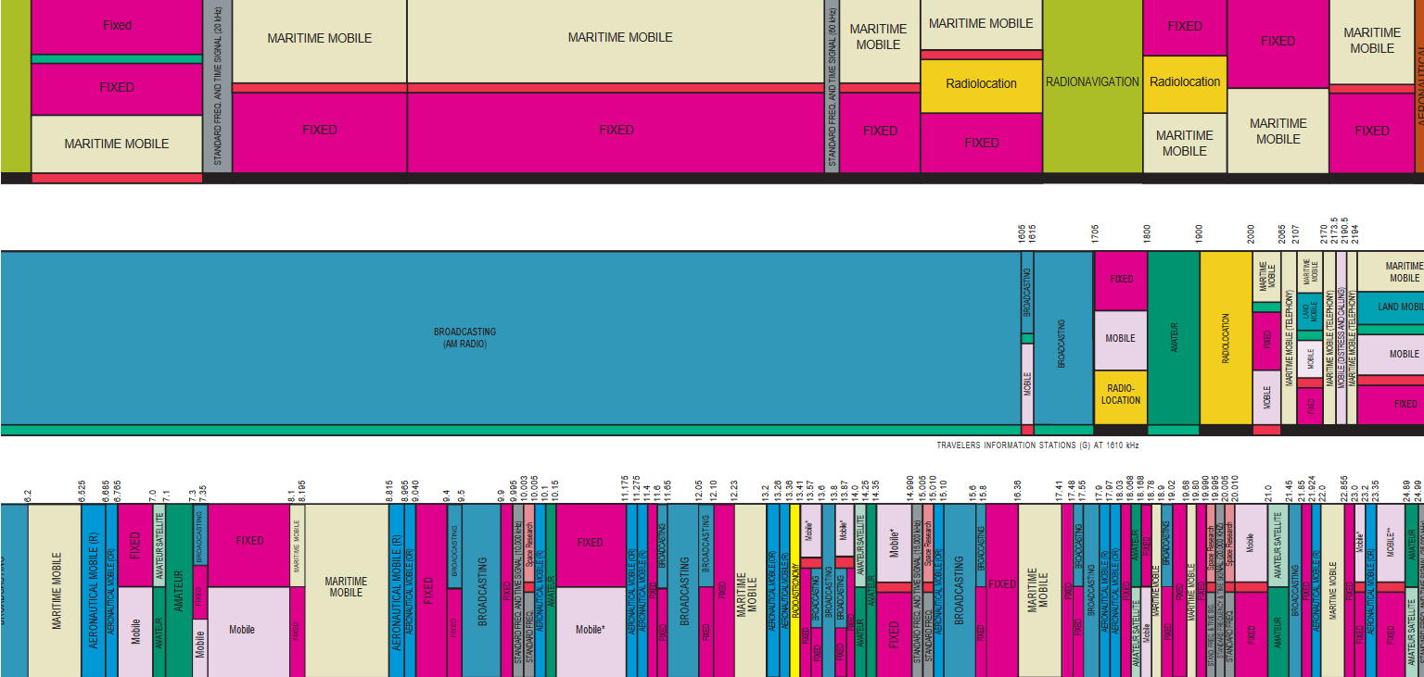
Keep in Mind: U.S. Frequency Allocation:

